Slide 2
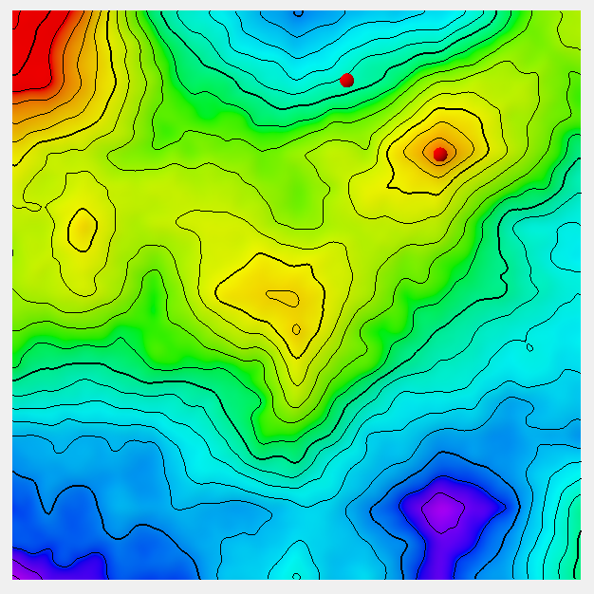
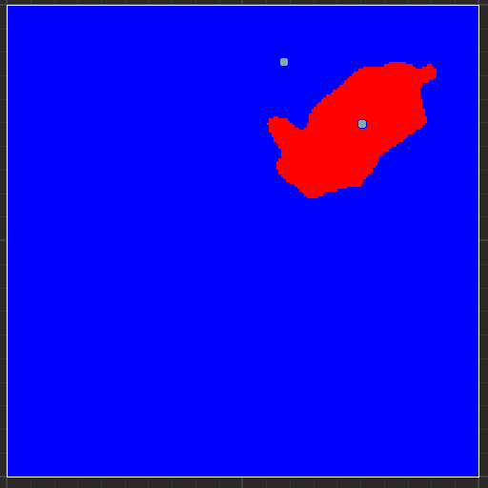
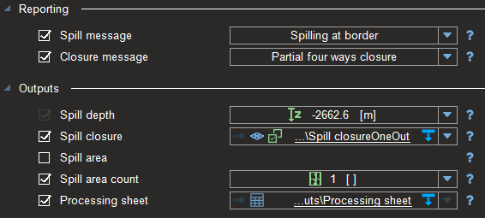
Case 1:
One single point set comprising two points is used as input for the Inside parameter
The deepest point is out of any structural closure (the unset border option is not used)
A partial closure is reported

Slide 3
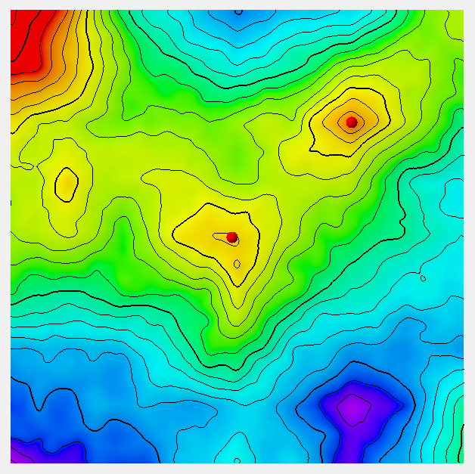
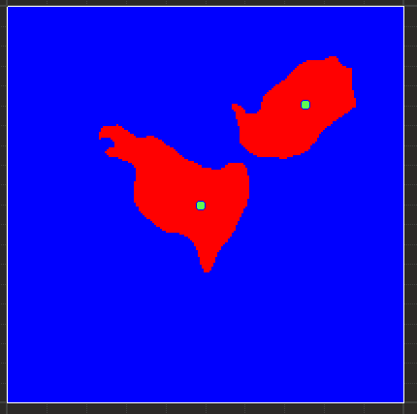
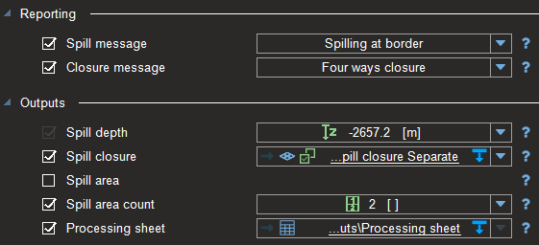
Case 2:
One single point set comprising two points is used as input for the Inside parameter
Both points are in separate structural closures
The « spill area count » is 2
The shallowest of both Spill depth is reported

Slide 4
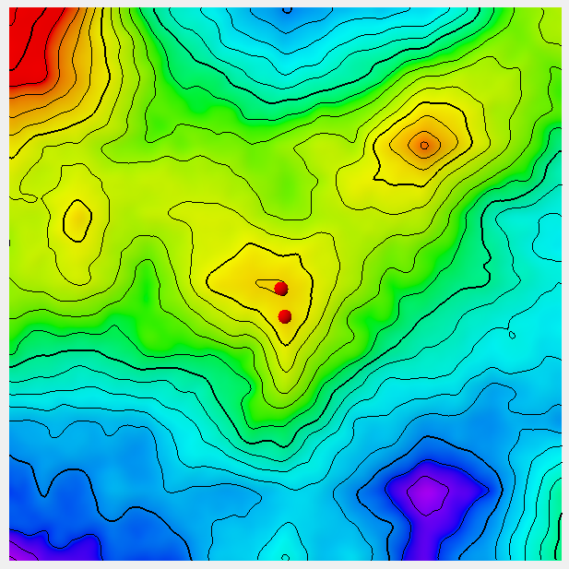
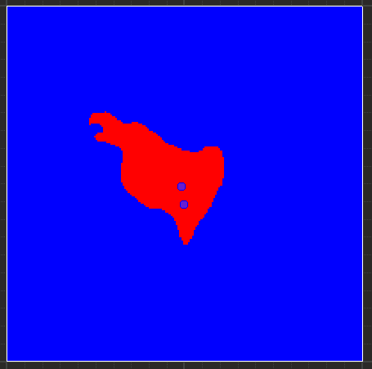
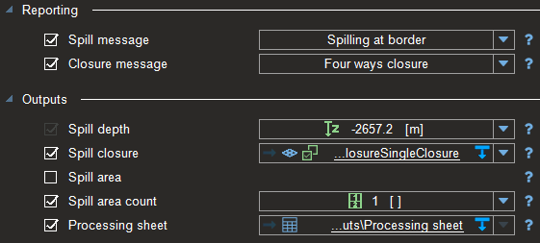
Case 3:
One single point set comprising two points is used as input for the Inside parameter
Both points are in the same structural closures
The « spill area count » is 1, and a Four way closure is reported

Slide 5
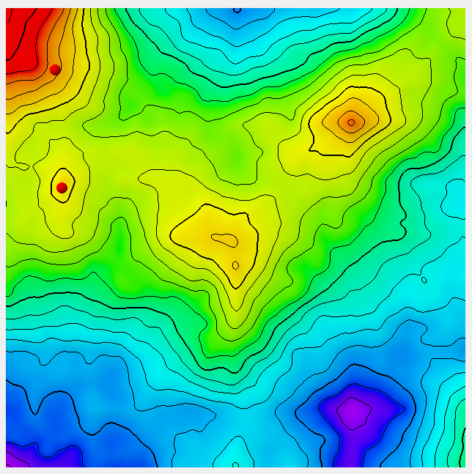
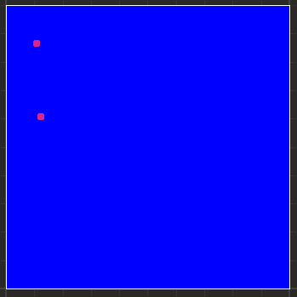
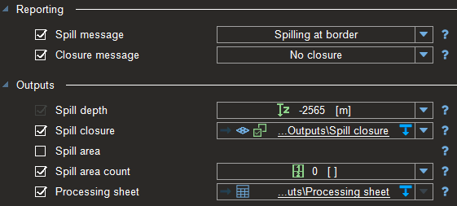
Case 4:
One single point set comprising two points is used as input for the Inside parameter
The shallowest point is out of any structural closure (the unset border option is not used)
No closure is reported, the « spill area count » is zero

Slide 6
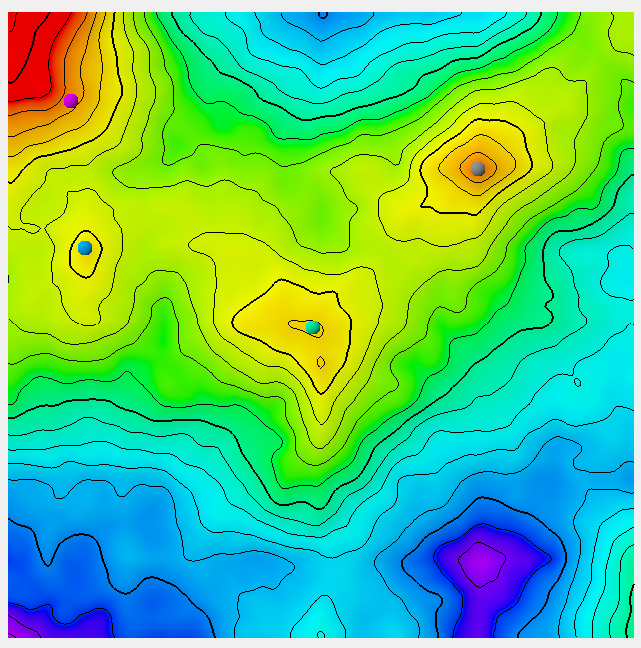
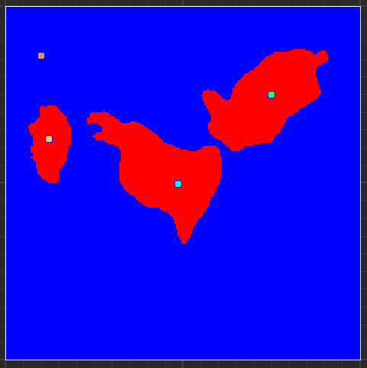
AllClosureMap
(from spreadsheet)
Case 5:
A list of 4 point sets comprising each a single point is used as input for the Inside parameter
The calculation is repeated four times
The AllClosureMap from the output sheet combines all closure maps in one

